Slide 1


REAL CONVERSATIONS
By Pernille Koch Erichsen

Slide 2
Ambition and purpose
The seminar strives to help Implement consultants creating even better conversations in the future by:
  Increasing the awareness of own strengths and development areas in conversations
  Sharing and learning from real experiences with conversations
  Training proven conversation and listening techniques and tools that will have a positive effect in all conversations

Slide 3

REAL CONVERSATIONS PROGRAM
TIME
DAY 1
TIME
DAY 2
09:00
Welcome and purpose
09:00
Good morning and reflection
What is a REAL conversation?
Giving information in a more motivating way - balancing advocacy and inquiry
Inquiry and Advocacy - the basics of conversations
Building confidence through appreciation and strengths
  Sharing cases
12:00
Lunch
12:00
Lunch
  Personal REAL conversation report – buddy reflection (W&T)
  The art of listening
  Sharing future cases
  Change-talk - How to evoke motivation and engagement in your conversations
  A REAL conversation (W&T)
  Next steps: 30 day challenge, Home assignments and exam
  Sharing cases
17:00
  Thanks for today
16:00
  Goodbye for now

Slide 4




REAL conversations
R
E
A
L
Relate:
Being genuinely interested in the other person. Being curious. Create relatedness and willingness to share - also vulnerabilities. Being honest.
Engage:
Setting the direction in the conversation around something that matters. Being courageous. Challenge and evoke change talk. Create the right energy – also with the body language.
Appreciate:
Being able to spot strengths in the other person. Think positive and focus on what works. Acknowledge the other person.
Listen:
Paying attention/being present. Making an effort to understand – also other perspectives than your own. Reflect what you hear. Balancing inquiry and advocacy.

Slide 5
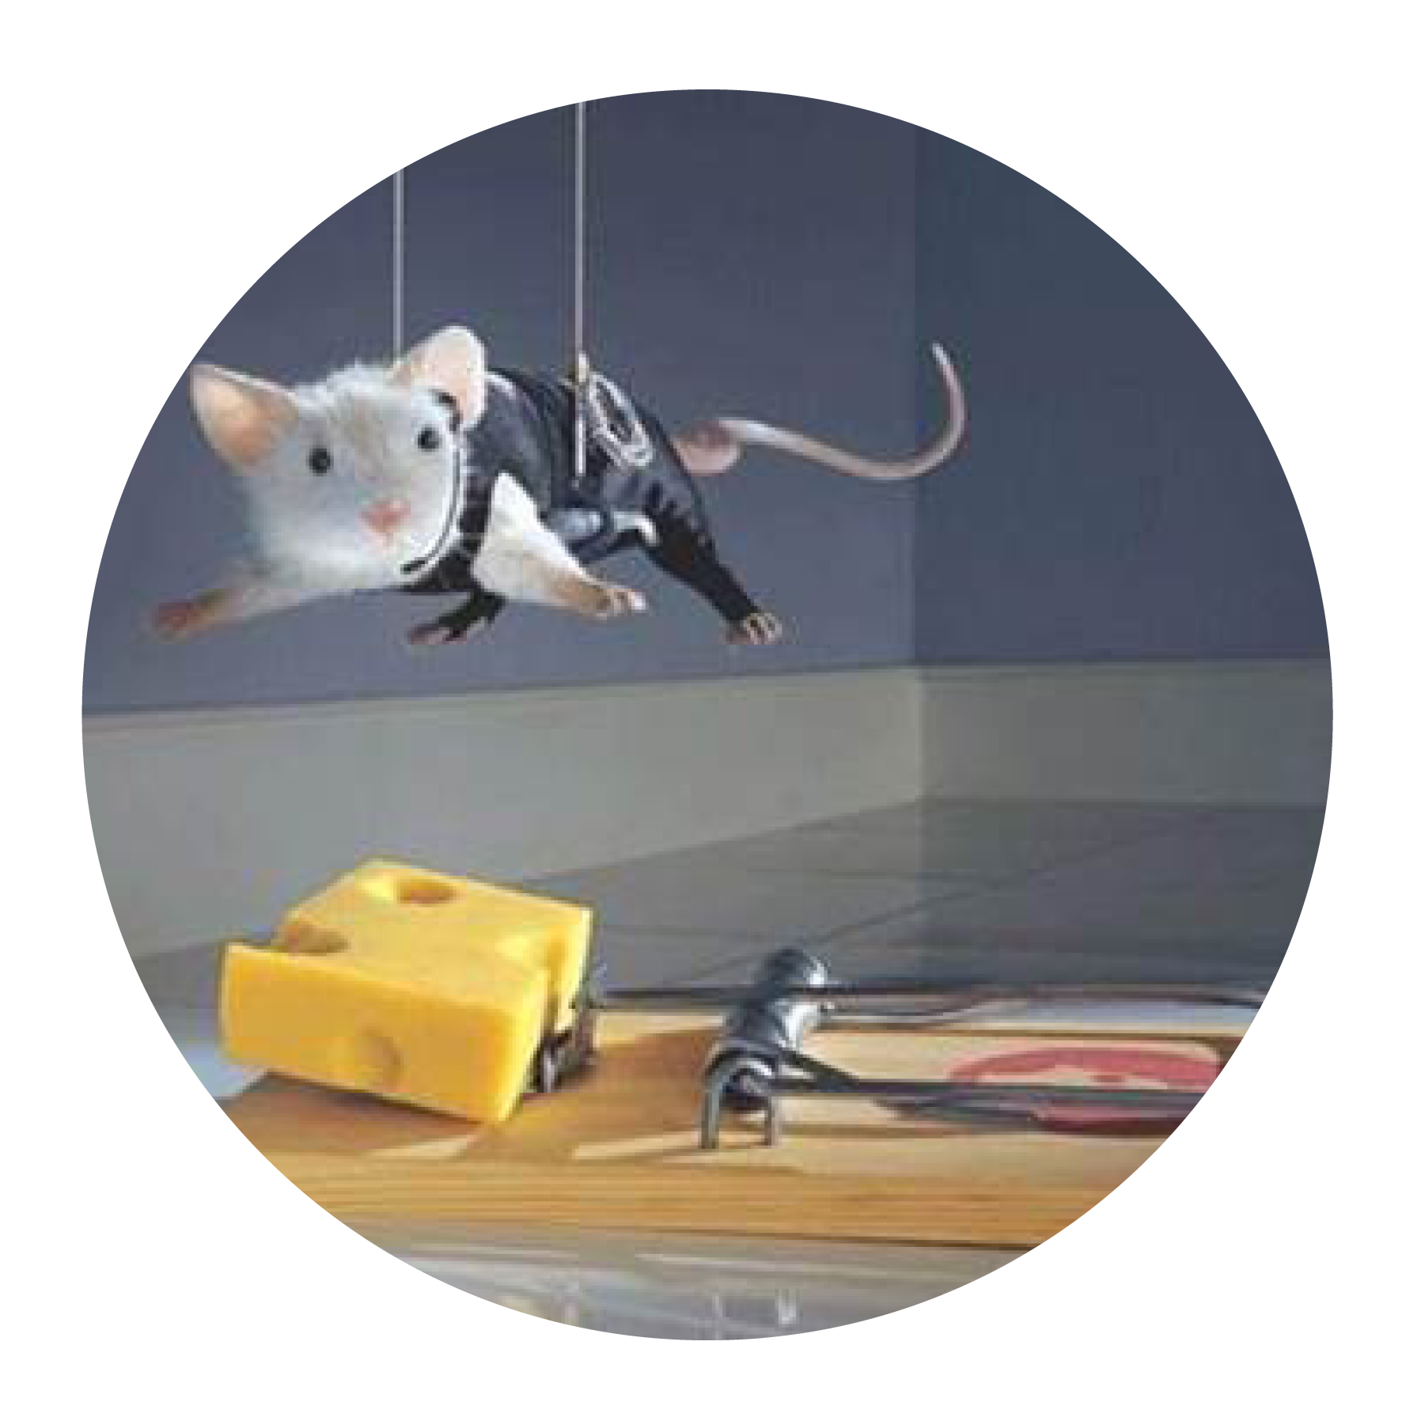
Conversation traps!
1
  The expert trap
2
  The problem trap
3
  The execution trap
4
  The listening trap

Slide 6
Dialogue – Advocacy vs. Inquiry
A
Advocacy: From my head to your head
I
Inquiry: From your head to my head
Source: Roger Martin/ Chris Argyris

Slide 7
Ladder of inference
Conclusion
Argument/logic
Selected data
Data/ Information
Soruce: Chris Argyris

Slide 8
360 degree REAL assessment
I ask questions with a genuine interest
I am willing to be honest in my conversations by sharing both strengths and weaknesses
I am curious to understand the other persons perspective.
I help to create direction in the conversation
I have the courage to challenge the other person in a conversation
I take responsibility for the energy in the conversation
I look for strengths in the other person or in the situation
I appreciate others in conversations regardless of whether we agree
I actively ask for what works
I listen just as much as I talk
I make an effort to be present in the conversation
I make sure that the other person feels understood.
1
2
3
4
5
6
7
8
9
10
11
12

Slide 9
Exercise
Individual reading of the report (10 minutes):
What made you happy/proud?
What surprised you?
In which specific area(s) do you want to improve/change?
With buddy – Walk and talk (40 min.)

Slide 10

«
WHAT WE HEAR OURSELVES SAY …
IS WHAT WE GET MOTIVATED TO DO
So therefore, it´s not without importance what we talk about, and how we talk about it
Source: Metastudies from Motivational Interviewing (Miller and Rollnick),
Positive Psychology (Seligman), Self-Determination Theory (Deci and Ryan)
10

Slide 11
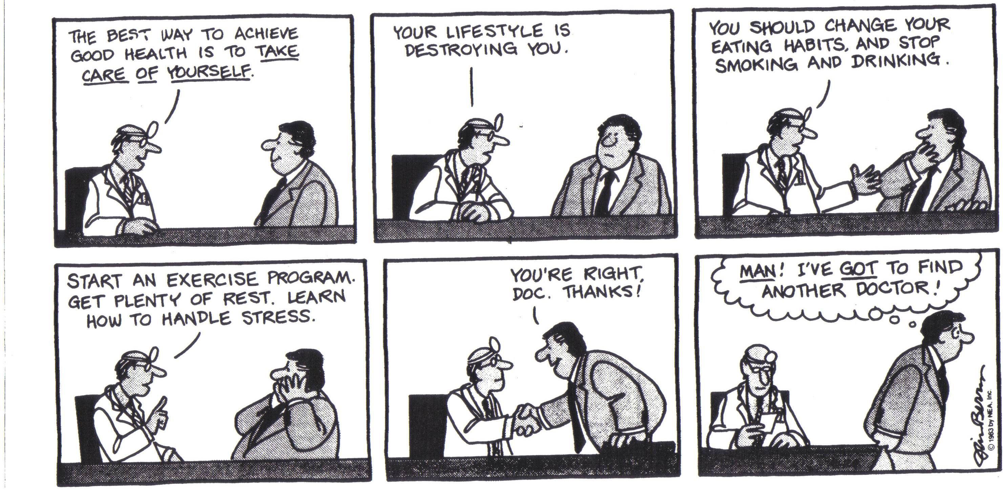
This is NOT a REAL conversation
Notes:
Pernille

Slide 12
Exercise – The Fixer (advocating)
    IN PAIRS
  Step 1
  A: Listen to B’s story – But not too long – You do not have that much time and you normally figure out answers quickly
  A: The Fixer
  B: Choose a behavior or situation which:
  You want to change, but haven't changed yet because you are ambivalent (use of bicycle helmet, less candy/sugar, start an exercise program, working less in the weekends etc.)
  Step 2
  Explain why B should change behavior
  Tell B at least 3 advantages by changing behavior
  Tell B how she/he can change the behavior
  Stress how important it is to B to change the behavior
  If needed order B to do it!

Slide 13




Drivers of intrinsic motivation and engagement
..…also in conversations
Purpose
(Formål)
Relatedness
(Fælleskab)
Mastery
(Faglighed)
Autonomy
(Frihed)
Source:Self Determination Theory, Deci and Ryan, Motivational Interviewing, Miller and Rollnick; Dan Ariely, Daniel Pink
Notes:
Pernille
Feedback can create purpose and mening – it can trigger our motivation drivers (autonomy, competencies, relatedness)
Self Determination Theory: Autonomy (interplay, reflections), Competence (contribution), Relatedness (psychological safety, interplay)
How can we do this when giving feedback?
I relation til Competence - Jf til “effort” – the motivation of doing an effort and using your competencies. “The IKEA effekt” and the story about “Cake mixes” from the 40´ies by Dan Ariely

Slide 14

Conversation strategies that evoke motivation and engagement
Importance
Motivation/
Engagement
Confidence
Source: Motivational Interviewing, Mille and Rollnick

Slide 15
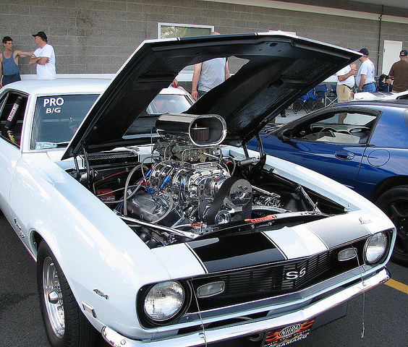
CHANGE TALK
IS THE ENGINE
Desire
Commitment
Abilities
Actions
Reasons
  Taking steps
Needs

Slide 16
Exercise – The Engager (balancing advocacy and inquiry)
    In pairs
A acts as The Engager
B , same situation as before
  Step 1
  Step 2
Listen carefully to B’s story like it´s the first time you hear it; be curious and try to understand
Ask 4 questions:
    What makes you want to change this (situation or behaviour)?
    On a scale from 1-10 how important is this change for you?
    Why do you say …. and not 2?
    How would you feel if you succeed with the change?
    A summaries what you just heard : B’s thoughts about the situation and B’s reasons for making a change,
    and finally A ask the question : This is how I see it. Is that also how you see it?

Slide 17
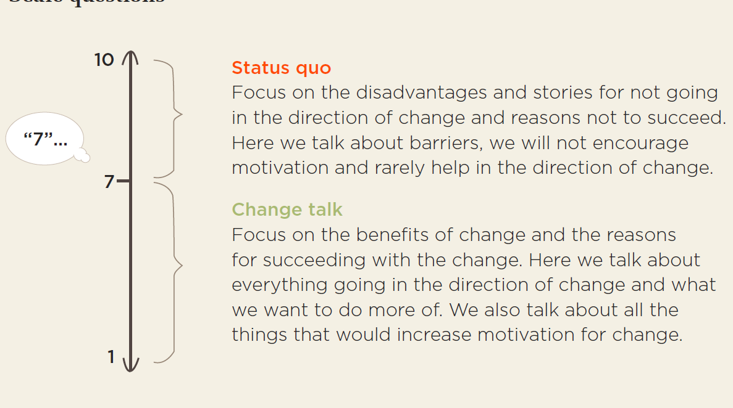
Status Quo vs. Change Talk - your questions matters
6

Slide 18
There is a connection between your approach in a conversation, what you talk about and what happens after
Your approach in the conversation
What you make others talk about
What happens during and after the conversation, with the people you talk with
  Focus on purpose
  Focus on the relation (relatedness)
  Focus on competencies (mastery)
  Focus on autonomy
Motivation/
engagement
  Importance Confidence
  Desire
  Abilities
  Reasons
  Needs
  Commitment
  Actions
  Taking Steps
Source: Self-Determination Theory (Deci and Ryan), Motivational Interviewing (Miller and Rollnick)
Notes:
Forbindelsen mellem din adfærd, det personen siger og det personen efterfølgende gør
Sig lidt om Bem’s teori om forandringsudsagn: Self perception theory. Empiriske undersøgelser der viser sammenhængen mellem forandringsudsagn og forandringer. Lidt a la at smile for at blive glad.
Forandringsudsagn er ikke noget du giver klienten, men er noget du fremkalder hos klienten gennem åbne spørgsmål!
Bemærk: hvor kommer forandringsudsagnene fra? Din eller klientens mund?

Slide 19
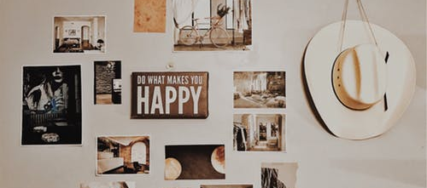
REAL CONVERSATIONS
Day 2

Slide 20
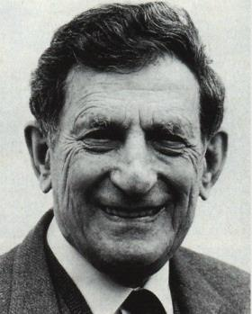
Bohms Circle
What inspires you…?
What disturbes you….?
Notes:
David Joseph Bohm FRS^{[1]} (December 20, 1917 – October 27, 1992) was an American scientist who has been described as one of the most significant theoretical physicists of the 20th century^{[2]} and who contributed unorthodox ideas to quantum theory, neuropsychology and the philosophy of mind.
Ask people to stand in a circle.
Present the talking stick. Everyone need to answer the two questions: What inspires you with what we are working with right now? And what distrubes you regarding our work/this topic right now?
People grap the talking stick at will (popcorn principle)

Slide 21

How to give information in the REAL way – remember to knock on the door
  Ask permission. Explore if the person wants the information and if the person already knows something about the subject your are going to inform about (”knocking on the door”)
  Give the information in a way where you stay in your own half – you are an expert within a field, but NOT an expert on the person you talk with
Explore what the person got out of the information and how he/she can relate or use the information that has been given in his/her own situation
REAL information always starts and ends with a question
Source: Motivational Interviewing (Miller and Rollnick)
Notes:
Pernille
I motivational interviewing er det i orden at være ekspert og give information – man skal bare gøre det på en motiverende måde ved at sprøge om lov til at give informationen, evt. understrege autonomi, give informationen på en neutral måde, og udforsk til sidst hvordan personen kan relatere sig til den givne informaion,

Slide 22
Information giving in a REAL way
In groups of 3-4 persons
Think of some information you would like to give to a client or colleague
In groups – trying out a new technique:
A : Give the information to B by using some of the elements you just heard about.
B : Receive the information and play along ;-)
C (D) : Observe and give feedback to A – what worked and where could it be even better; going forward, A and B share what they experienced
5 min. each including feedback – keep track of time
How did it go with:
  asking permission?
  asking about what the person already knew or wanted to know more about?
  staying in your own half?
  ending with a question (that might evoke change talk) ?
Switch roles

Slide 23

«
REAL CONVERSATIONS:
APPRECIATE
What we look for is what we see …

Slide 24
Appreciative inquiry
Some basic principles
1
  What we ask determines what we find
2
  What we find determines how we talk
3
  How we talk determines how we think
4
  How we think determines what we achieve
  https://www.centerforappreciativeinquiry.net/more-on-ai/principles-of-appreciative-inquiry/

Slide 25
The traditional approach to change and change conversations
Identify the problem
Organisation becomes ”Problems to be solved”
Analyse possible causes
Implement best solution
Generate solutions

Slide 26
The Appreciative Inquiry (AI) approach to change and change conversations
Inquire into what works
Organisation becomes ”Possibilities to happen”
Imagine how good it could be
Commit to what will be
Agree how good it should be

Slide 27
Why focus on strengths?
Gallup recently completed global research on companies that implemented strengths-based management practices. Business Journal - January 3, 2017
Gallup found that 90 % of the groups studied had performance increases at or above the following ranges:
    10-19 % increase in sales
    14-29 % increase in profit
    3-7 % higher customer engagement
    6-16 % lower turnover (in low-turnover organizations)
    26-72 % lower turnover (in high-turnover organizations)
    9-15 % increase in engaged employees
http://www.gallup.com/businessjournal/200123/strengths-based-cultures-attract-top-talent.aspx?utm_source=alert&utm_medium=email&utm_content=morelink&utm_campaign=syndication

Slide 28
Why think appreciatively?
  How did your organisation balance your communication through the transformation?
  Transformation success
  % of respondents1
  Not successful n = 150
  Somewhat successful
  n = 1,540²
  Very successful
  n = 838²
  Extremely successful
  n = 166²
  A roughly equal mix underlining both problems and successes
  Focused on what worked asking how we could build on that in other areas
  Focused on what did not work and who to fix it
  Other
  Do not know
1 Data are weighted by GDPs of constituent countries to adjust for differences in response rates.
2 Figures do not sum to 100%, because of rounding
3.199 Executives, July 2008, Mckinsey Quarterly

Slide 29
Talents and pitfalls – a way of looking for the positive in the negative
Too much of a good thing
Talent (core strength)
Pitfall
A behaviour/trait that comes natural to you
A main, positive characteristic
Is done with a good intention
The talent works well in many situations
When the same talent is used too much or in the wrong situation
Can cause frustration for others
May be a blondspot or something you see yourself
“ENGAGED”
”DOMINATING”
  Source: Daniel Ofman, Core Qualities, 1992

Slide 30
Talents and pitfalls – a way of looking for the positive in the negative
Too much of a good thing
Talent (core strength)
Pitfall
“ENGAGED”
”DOMINATING”
Too much of a good thing
Allergy!
Development area
What you “just can’t tolerate!”
Too much of the development area behavior
When you see an allergy in others, it can drive you into your own pitfall
Opposite of the pitfall, but framed in a positive way
Something that creates a better balance between Talent and Pitfall
Something you might aspire to
“PASSIVE”
”INCLUIDING”
  Source: Daniel Ofman, Core Qualities, 1992

Slide 31
Talents and pitfalls exercise
1
Individually (2. min):
Think of a colleague or a client that has a behaviour that triggers you in a negative way. Write down on a red paper card 2-3 pitfalls that you see in the person
With buddy:
Share the pitfalls (please do not mention the name of the person, if it´s a person both of you know)
2
3
Individually (2. min):
Note on green paper cards – what can I do think or do differently in my conversations with this person.

Slide 32
Examples of strengthbased-questions
Think about a strength/ quality you are happy or proud about in terms of you or your organizations. What would that be?
If you were to put a metaphor on this strength/ quality, what would that be? (sport, nature, an animal, a color, a song, a cartoon or movie character, or something else – use the first image that comes to you)
When was the last time you saw or used that ability? Describe the situation. Also describe what effect it had on the other(s) involved in the situation, and the effect it had on yourself?
What are you hoping to achieve in general when you or your organization use that strength/ quality? For your colleagues? For you clients? For the world? For yourself?
At the tables – come up with other strength based questions that you might use in your conversations.

Slide 33
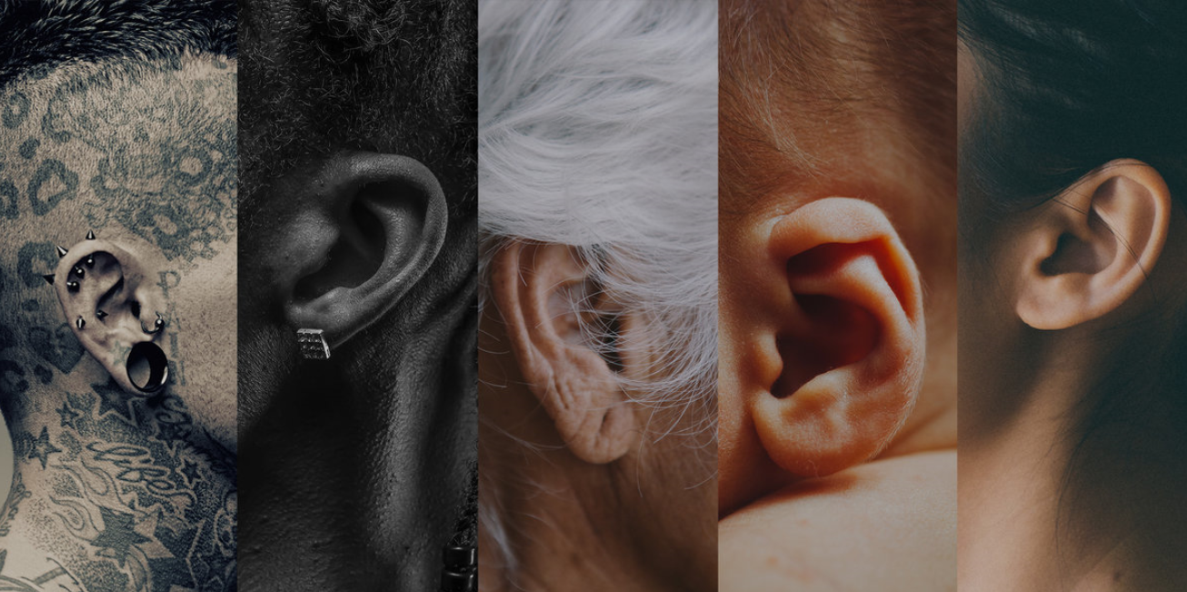
The art of listening
http://www.npr.org/programs/ted-radio-hour/411697251/the-act-of-listening
Notes:
Dave Isay (documentarist - in 2016 he won 1 mil dollar TED price given to the one with a vision to change part of the world) Dave Isay opened the first StoryCorps booth in New York’s Grand Central Terminal in 2003 with the intention of creating a quiet place where a person could honor someone who mattered to them by listening to their story. Since then, StoryCorps has evolved into the single largest collection of human voices ever recorded. His TED Prize wish: to grow this digital archive of the collective wisdom of humanity. Hear his vision to take StoryCorps global — and how you can be a part of it by interviewing someone with the StoryCorps app.
We all have a story worth listening to!
People coming in telling their own story with inspiration from a lot of questions:
How do you want to be rememberd, what are the most important lessons you learned in life, is there anything you never told me, that you want to tell me now? It´s the kind of questions that draw you together that get asked in Storycorp (4:18-8:08)

Slide 34
2 Levels of listening
You talk about yourself and you become wiser on yourself
Result:
Your own viewpoint will be put into perspective (not the other person’s viewpoint)
Inner
listening
  ”I know that feeling, because once when I was a meeting Iike that ...!
  You are listening to understand the
  other person
Result:
The other person is mirrored, understood, contained, challenged, supported. Sometimes the other person´s viewpoints, thoughts, feelings will be put into new perspectives.
  ”How did you feel in that situation?
  “It seems like you are having second thoughts about how you dealt with the situation…... Is that how you see it?
Active
listening

Slide 35
Examples of inner listening:
  Ahh yes, I know this from my sister …
  It reminds me about that time …
  That was just like I experienced yesterday, when I …
  Your problem is more about …
  I do not agree in …
  Maybe you should rather do …
  What you really mean is …
Notes:
Reflekterende lytning er ikke spørgsmål men er gæt formuleret som udsagn – tonen går ikke op i slutningen men ned
Fortæl lidt om de semantiske overvejelser:
1) Hvad sker der hvis man i stedet sagde: ’Så du må til at ændre projeket ’?
2) Hvad sker der hvis man bruger et andet ord end bekymringer i den anden sætning? F.eks. ’at være skræmt’?
3) Hvad sker der hvis man sagde: ’Så nu må du i gang med at dyrke motion og spise sundt’?
Lav evt. en øvelse med reflekterende udsagn hvis du ikke kan nå dem der er i slidsene.
3: Det er vigtigt for dig…
4: det er nu det er nu!

Slide 36
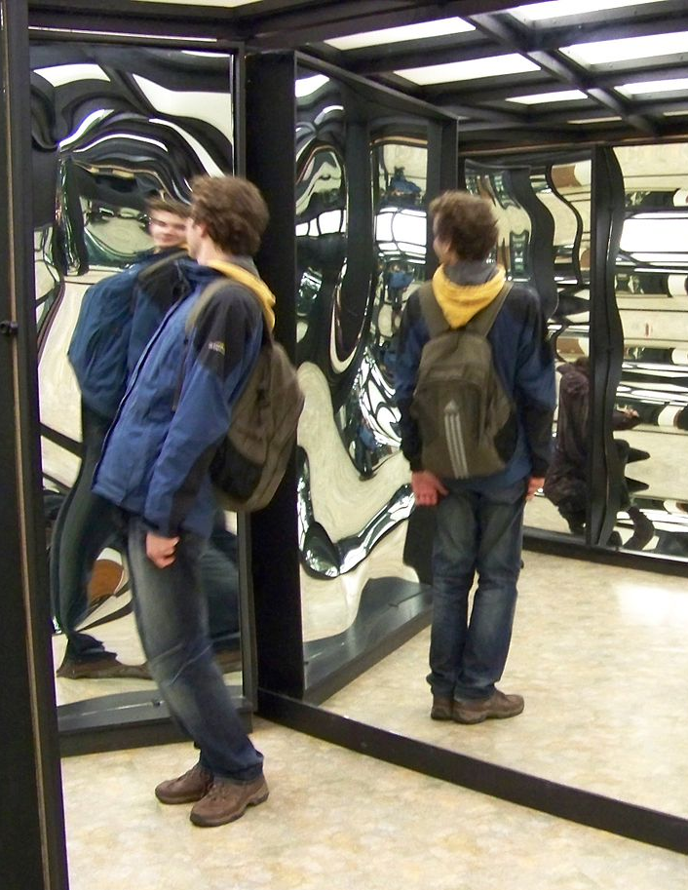
Active listening (reflections)
Active listening:
Reflecting what the person says – sometimes from the same angle and sometimes from new angles.
  Simple reflections are a direct mirroring of what you've just heard without adding new meaning.
  Complex reflections are like a mirror of what you just heard, but with an attribution of new meaning (your interpretation and angling of what you hear).
Notes:
We distinguish between simple reflections and complex reflections
Simple reflections can be helpful in getting the person to talk further and more in-depth, but as a rule they do not get the persons to see things from new angles.
By using different words to reflect what the person has said and put it in a different light, you can get the person to reflect on things in new ways, helping them to clarify matters in regard to their own intrinsic motivation. Complex reflections therefore centre on your interpretation of what the person is saying.
Reflekterende lytning er ikke spørgsmål men er gæt formuleret som udsagn – tonen går ikke op i slutningen men ned
Fortæl lidt om de semantiske overvejelser:
1) Hvad sker der hvis man i stedet sagde: ’Så du må til at ændre projeket ’?
2) Hvad sker der hvis man bruger et andet ord end bekymringer i den anden sætning? F.eks. ’at være skræmt’?
3) Hvad sker der hvis man sagde: ’Så nu må du i gang med at dyrke motion og spise sundt’?
Lav evt. en øvelse med reflekterende udsagn hvis du ikke kan nå dem der er i slidsene.
3: Det er vigtigt for dig…
4: det er nu det er nu!

Slide 37
Example of active listening
  Something from a conversation:
  A: “I think that you made the decision in our business area too quickly.
  We do not have the necessary knowledge, if you ask me.
  We should wait and gather more knowledge!”
  B: “In your opinion, we do not have the necessary knowledge!”
At the tables:
Talk about how you could make a complex reflection here?

Slide 38
Ratio: Questions vs. Reflections
Conversation:
Ratio:
1 question to 1 or 2 reflections
‘Warm/hot’ conversation:
Ratio:
1 question to 2 or 3 reflections
Source: Metastudies - Motivational Interviewing

Slide 39
Reflections can help others stay in their ”train of thought”, without jumping too much back and forth based on new questions
Question
Question
Question
QUESTION
FOCUSED
Question
Question
Question – pointing back to something
Question
Question
Reflection
REFLECTION
FOCUSED
Question
Reflection
Reflection
Reflection
Reflection
Question
Question

Slide 40

Active listening
Often starts with:
  It seems like …
  So you might …
  You might feel that …
  You have an experience of …
  It sounds like you …

Slide 41

Notes:
The Rounder with Theresa Moyers. Ask the particpants to note on a paper how many reflections they hear and how many questions they hear.
WAIT A FEW SECONDS. YOUTUBE VIDEO SHOULD APPEAR AFTER 5 SECONDS
If not, go to: https://www.youtube.com/watch?v=FBDIl0ftIdc&t=0s

Slide 42
Active listening exercise – with complex reflections
Active
listening
(5 min.)
  With buddy – sitting across from each other – knees nearly touching ;-)
  A tells a story to B about something that is an issue for her/him
  B listens with active listening (focus on reflections)
  A and B talk about how it was to have this conversation
Active
listening
(5 min.)
  B tells a story to A about something that is an issue for her/him
  A listens with active listening (focus on reflections)
  A and B talk about how it was to have this conversation

Slide 43
Apply REAL conversations tools to client case
Individually (3 min): Think of a client meeting/ workshop in the near future. Choose one of the REAL tools/ techniques and sketch out how it could be applied in your case.
In trios (same groups as in ”knocking on the door” exercise) (20 min). Share the cases and choose one case to work with. Get sparring on which tools/ techniques can be applied and how.

Slide 44
FEEDBACK
Notes:
Some of these studies also show, that leaders that gives mostly positive feedback have employees that are up to 30 times more engaged in their work than leaders that gives no or very rarely feedback. And then you might think – is it only positive feedback that works? Well the same studies also show, that the leaders that gives constructive negative feedback have employees that are up to 20 times more engaged in their work than leaders that gives no or very rarely feedback. So it really matters how much you give or ask for feedback – all concrete, caring and constructive feedback has a positive effect.

Slide 45

What is new in the real feedback approach?
… BEING CURIOUS
«
“I have a view worth hearing, but I may be missing something.”
Chris Argyris

Slide 46
Real feedback – balancing advocacy and inquiry
CONCRETE
CARING
CONSTRUCTIVE
CURIOUS
Notes:
Rikke

Slide 47
Buddy feedback exercise – Walk & Talk
Have a conversation where you give REAL feedback to your buddy:
Have a conversation about the feedback.
Try out one or two elements from the past 2 days of training & learning
balancing advocacy and inquiry
conversations strategies (important/confidence)
evoking change-talk
“knock on the door”
active listening
being curious!
CONCRETE
CARING
CONSTRUCTIVE
CURIOUS

Slide 48
Exercise: Apply REAL conversation to a client case
1
Individually (3 min):
Think of a client meeting or workshop you are having in the near future. Select one of the tools/ techniques from the REAL Conversation toolbox and sketch out how it could be applied.
In groups (20 min in total):
Share the cases and choose one or two case to work with - getting sparring on which tool/techniques can be applied.
2
3
Plenary:
Sharing examples.

Slide 49

MY 30-DAY
CHALLENGE

Slide 50
REAL conversations
  What are my key takeaways from the last two days?
  What has become important for me to work more with in my conversations going forward and why?
  Therefore, I choose my 30-day conversation challenge to be … (something you could start doing tomorrow, if you want to)

Slide 51
Assignments before the exam (optional)
Make a meeting appointment with you buddy in 30 days and share how you have worked with you 30 days challenge.
See videos with Roger Martin around Advocacy and Inquiry – you will have them sent to you by the CIA (Change Impact Academy) within the next couple of weeks.
The exam
The exam is ½ a day
Bring your own case:
Think of a case that you would like to put into play at the exam (could both be a conversation you have had and want to “try again” or it could be a future conversations with a client or a colleague that you will have in the near future)
On the examination day:
10 minutes conversation with a ‘client’ or ‘colleague’ (an actor will play the role as your client or colleague).
10 minutes feedback from your group. Feedback will be given by using the REAL Conversation Coding.
Notes:
https://www.youtube.com/watch?v=FBDIl0ftIdc
– coding the rounder (15 min)

Slide 52
REAL Conversation Coding (RCC)
Focus person chooses what the Observer should make a note of: A/I or active listening/open questions.
Make a tic for every time it occurs.
Advocacy (from my head)
Active listening (reflections)
Inquiry (from your head)
Number of questions (opened/closed)
Observer notes down examples of REAL elements and summarizes at the end from 1-5 on each dimension.
 |  |  |  |  |  | Examples (content, body language, voice)
Relate: Being genuinely interested in the other person. Being curious. Create relatedness and willingness to share - also vulnerabilities. Being honest. | 1 Low focus | 2 | 3 | 4 | 5 High focus
Engage: Setting the direction in the conversation around something that matters. Being courageous. Challenge and evoke change talk. Create the right energy. | 1 Low focus | 2 | 3 | 4 | 5 High focus
Appreciate: Being able to spot strengths in the other person. Thinking positively and focus on what works. Acknowledging the other person. | 1 Low focus | 2 | 3 | 4 | 5 High focus
Listen: Paying attention/being present. Making an effort to understand – also other perspectives than your own. Reflect what you hear. Balancing inquiry and advocacy | 1 Low focus | 2 | 3 | 4 | 5 High focus

Slide 53
REAL conversations
R
E
A
L
Relate:
Being genuinely interested in the other person. Being curious. Create relatedness and willingness to share - also vulnerabilities. Being honest.
Engage:
Setting the direction in the conversation around something that matters. Being courageous. Challenge and evoke change talk. Create the right energy – also with the body language.
Appreciate:
Being able to spot strengths in the other person. Think positive and focus on what works. Acknowledge the other person.
Listen:
Paying attention/being present. Making an effort to understand – also other perspectives than your own. Reflect what you hear. Balancing inquiry and advocacy.

Slide 54
Rule #1 Balance advocacy and inquiry
  No naked advocacy!
  No naked inquiry!
  Always advocate your point of view and combine with inquiry

Slide 55
Rule #2: There is always a ladder of inference
  If you don’t inquire into the ladder, you fill it in yourself
  Would you rather have them guessing?

Slide 56
Rule #3: The left-hand side can’t be ignored
It gets hotter and hotter
It bleeds into the right-hand side
The other feels that something is wrong

Slide 57



Rule #4: Know how you intervene
1%
NAME THE FEELING
HOT
    1%
4%
INQUIRE INTO THE UNDERSTANDING
WARM
    4%
95%
COMBINE AS USUAL
COLD
    95%
Notes:
HOT: VI KAN IKKE LYTTE NÅR SAMTALEN ER HOT – DERFOR BLIVER VI OFTE NØDT TIL AT STOPPE SAMTALEN.

Slide 58
Rule #5: Frame your role
“I have A view worth hearing, but I may be missing something.”
And …
  Do not be hard on yourself
  Perfection is not the goal (be better and fail less)

Slide 59
Going into a meeting …
  What is my ladder?
  What is their ladder?

Slide 60
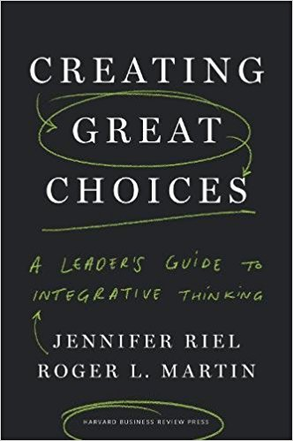
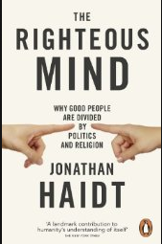
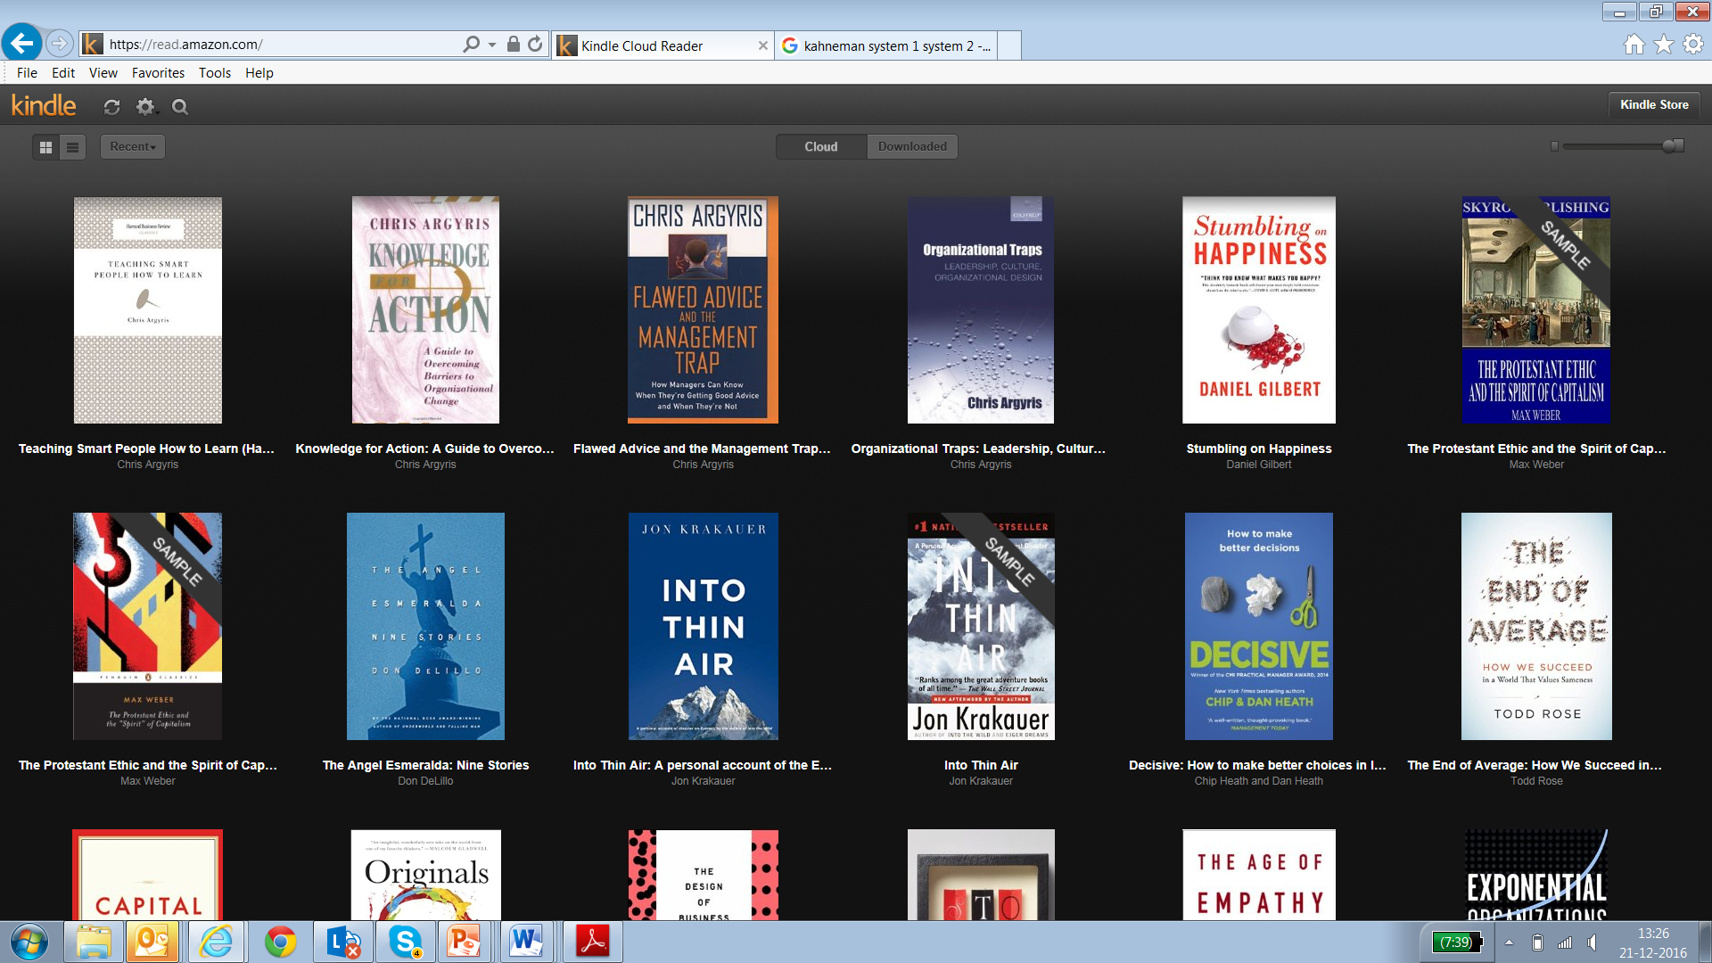
Literature on Advocacy and Inquiry
Roger Martin
Jonathan Haidt
Chris Argyris
Chris Argyris
Creating great choices
The Righteous Mind
Flawed Advice and the Management Trap
Organizational Traps

Slide 61
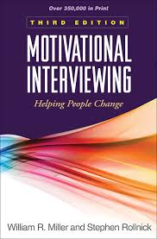
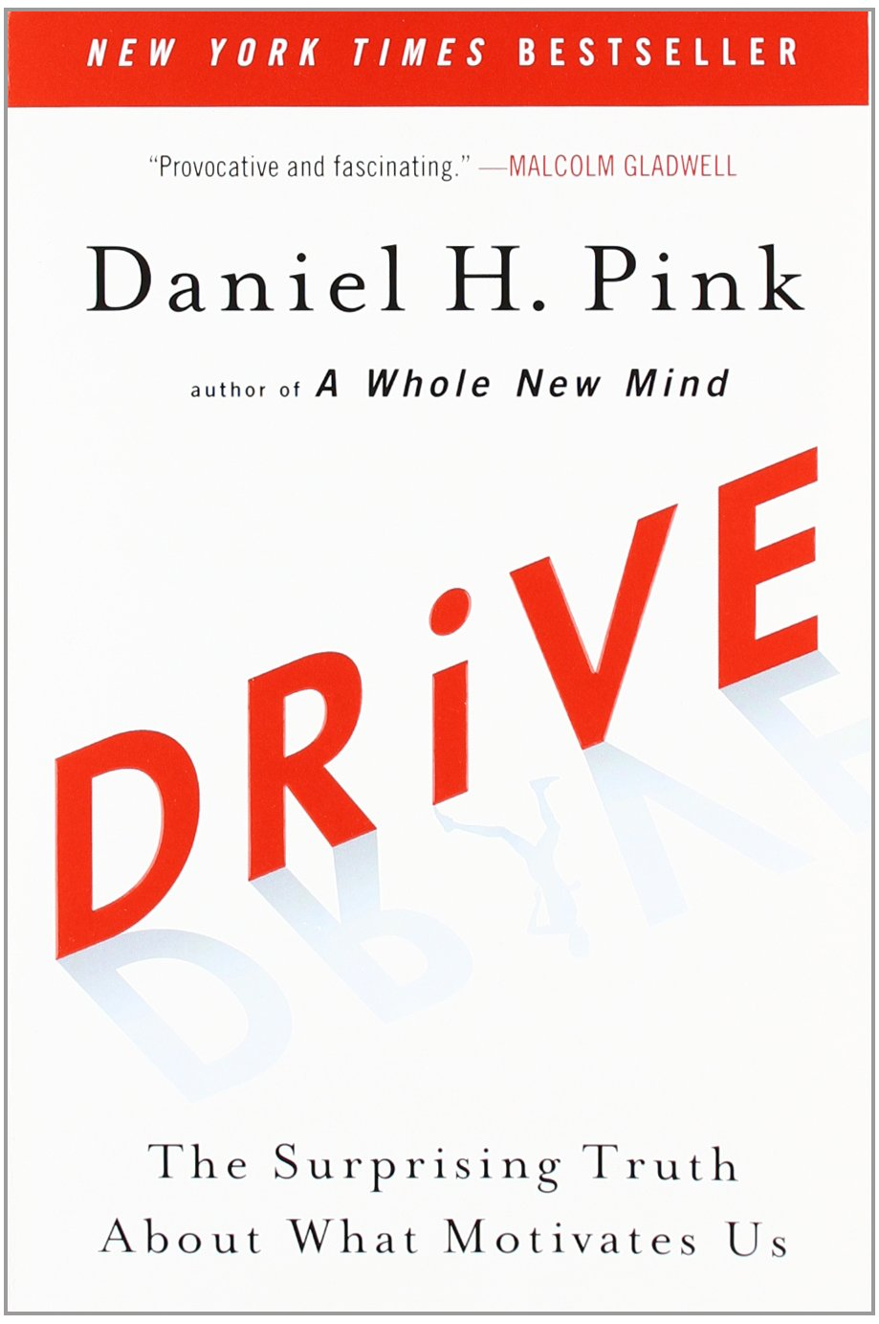
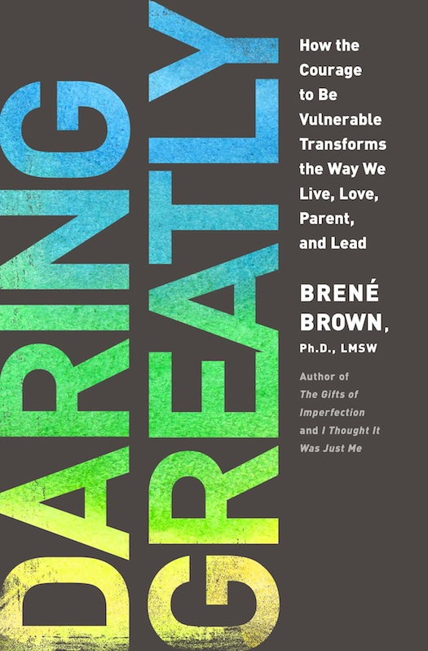

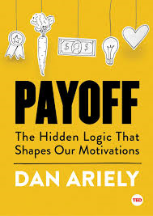
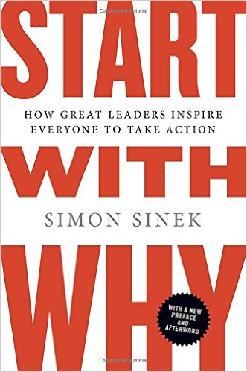

Literature on Motivational Drivers in Conversations
William Miller & Stephen Rollnick
Daniel H. Pink
Brené Brown
Maryléne Gagne
Motivational Interviewing – Helping People to Change
Drive - The surprising Truth About What Motivate Us
Daring Greatly
Work Engagement, Motivation , and Self-Determination Theory
Dan Ariely
Simon Sinek
David Cooperider & Diana Whitney
Payoff - The hidden Logic that Shapes Our Motivation
Start with why
Appreciative Inquiry – A Positive Revolution to Change

